Slide 1
Introduction to Quantum Algorithms
Paramjot Singh
Notes:
Both

Slide 2
Overview
Introduction
Data Encoding
Quantum Circuits
Simon’s Algorithm
Grover’s Algorithm
Future and Conclusion
Useful Resources
Notes:
Param

Slide 3
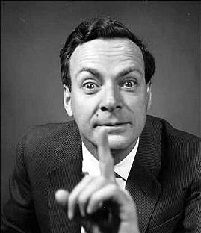
What is Quantum Computing ?
“I think I can safely say that nobody understands quantum mechanics”
- Richard Feynman
Notes:
Param Richard Feynman was american physicist and said in 1982. Later in late 90’s 1994, Peter Shor came up with quantum algo for factoring of very large polynomials. 1997, Lov Grover developed quantum search algo with O(√N) complexity.

Slide 4
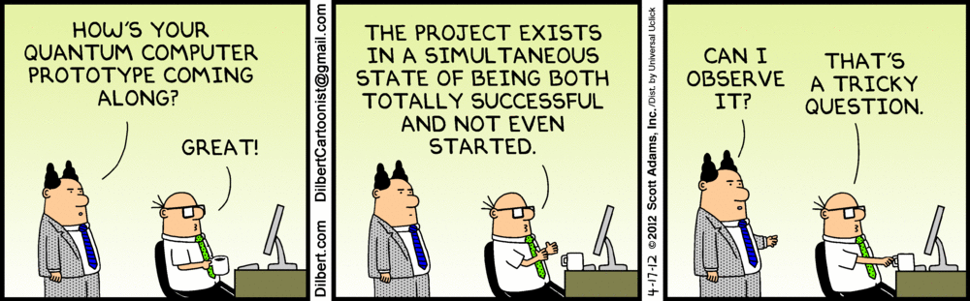
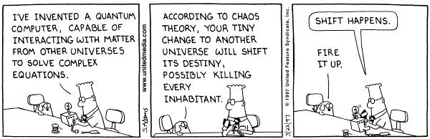
Quantum computer is a machine that performs operations based on the laws of quantum mechanics, such as superposition, entanglement, etc.
Notes:
Param

Slide 5
Timeline of Quantum computing
1980 Yuri Manin proposed an idea of quantum computing
1981 Richard Feynman proposed a basic model for a quantum computer
1982 Paul Benioff proposed the first theoretical framework for a quantum computer
1994 Peter Shor discovered quantum algorithm to factor large integers quickly.
1996 Lov Grover, at Bell Labs, invented quantum database search algorithm.
1998 First working 2-qubit NMR computer demonstrated at UC Berkeley.
2001 First working 7-qubit NMR computer demonstrated at IBM's Research Center and First execution of Shor's algorithm.
Notes:
Param
Yuri Manin, Russian mathematician first proposed idea of quantum computing in 1980, later after 1 year Richard Feynman at Ist conf at Physics of Computation at MIT proposed basic model for a quantum computer that would be capable of such simulations. Just after one year Paul Benioff proposed first theoretical framework for a quantum computer. Peter Shor, at AT&T's Bell Labs discovers algorithm to allow quantum computers to factor large integers quickly. Shor's algorithm could theoretically break many of the cryptosystems in use today. In 1996, Lov Grover, at Bell Labs, invents quantum database search algorithm with O(sqrt(N)).
NMR - Nuclear Magnetic Resonance, Ion Trap architecture

Slide 6
Data encoding & representation
Notes:
Laksh

Slide 7
Data Representation
A bit of data is encoded by single electron of atom that is in one of the two states, which is denoted by |0> and |1>, representing the ground and excited states of atom respectively. It’s called qubit
Ground State |0> Excited State |1> Superposition α0 |0> + α1 |1>
Notes:
Laksh

Slide 8
Super-position
The superposition principle states that the electron will be in a state (a1 |0> + a2 |1>), the coefficients a1 and a2 represent complex numbers such that |a1|² + |a2|² = 1. a1 and a2 represent the amplitude of the ground and excited states.
-This superposition (a1 |0> + a2 |1>) is the basic unit of encoded information in quantum computers and is called a qubit.

Slide 9
Superposition
The concept of superposition suggests that the electron cannot decide if it’s in the excited or ground state. It is tempting to think of the amplitudes a0 and a1 as probabilities but, we cannot since they can be imaginary. This is one of the aspects of quantum physics that extends beyond our intuitions of the physical world.
To get the state of the electron we need to take the measurement of the electron’s state, this gives us 0 or 1 depending on the state. The outcome of measurement is 0 for probability |a1|² and 1 for probability |a2|² .
Notes:
Laksh

Slide 10
How to perform operations using Qubits?
Quantum Circuits
Notes:
Param

Slide 11
Geometric Interpretation of K-level system
As Laksh explained, Superposition principle says:
|Ψ> = α0 |0> + α1 |1> + … + αk-1 |k-1> and αj ϵ C
Ground State |0>
First Excited State |1>
::::::::::::::::::::::::::::::::::::
K-th Excited State |k-1>
But, interpreting what this state means is not very easy, Since, it’s hard to make sense when we say electron is in 1/2 + i/2.
Notes:
One way we can interpret this is by using measurement axiom, that is when we measure/look at the system, the probability that the outcome is j is alpha_j^2. But we know that the measurement disturbs the system, so the new state psi_dash will be jth excited state, if the measurement outcome was j

Slide 12
Geometric Interpretation of K-level system
So geometrically superposition principle says,
|Ψ> = α0 |0> + α1 |1> + … + αk-1 |k-1> ( Ket notation)
α0
= α1 ( Vector notation )
:
αk-1
|2>
|Ψ> = α0 |0> + α1 |1> + α2|2>
|1>
|0>
Ground State |0>
First Excited State |1>
Second Excited State |2>

Slide 13
Orthogonal
Subspace of u |Ψ> = 𝚺 αx |x>
|u> = 1/√N 𝚺|x>
Reflection of |Ψ>
about u

Slide 14
Quantum Gates
Bit Flip
α0 |0> + α1 |1>
X
α1 |0> + α0 |1>
Transformation matrix is
0 1
X =
1 0
Notes:
X basically flips the basis state.
X|0> = |1>
X|1> = |0>

Slide 15
Quantum Gates
Phase Flip
α0 |0> + α1 |1>
Z
α0 |0> - α1 |1>
Transformation matrix is
1 0
Z =
0 -1
Notes:
Z|0> = |0>
Z|1> = -|1>
Z|-> = |+>
Z|+> = |->

Slide 16
Quantum Gates
Hadamard transform
α0 |0> + α1 |1>
H
β0 |0> + β1 |1>
Transformation matrix for Hadamard gate
1/√2 1/√2
H =
1/√2 -1/√2
Notes:
One of the most important gate used in various circuits.
H|0> = |+>
H|1> = |->
H|+> = |0>
H|-> = |1>
Since, H and H_dagger (complex conjugate) is same, so Square of H is Identity. We can apply twice and we’ll reach where we start from.
Note: Two Hadamard gates used in succession can be used as a NOT gate

Slide 17
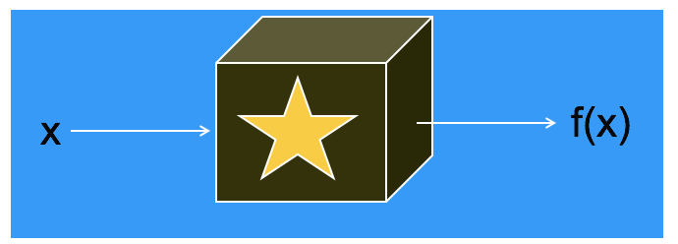
Demonstration of Quantum Algorithms
Here, we will look into a quantum algorithm to solve the challenge of finding a secret string ‘s’ in a function ‘f’ that maps n bit string to n bit string such that, f(x) = f(x+s).
Imagine we are given a black box to compute f, until we see a collision or until we don’t input two different values of ‘x’ such that f(x) is same for both, we don’t get a structure for ‘f’.

Slide 18
Demonstration of Quantum Algorithms
Here’s an outline of the quantum algorithm.
Set up random super-position
Fourier sampling to get y: y.s = 0(mod 2)
Repeat n-1 times to generate n-1 linear equations.
Solve for ‘s’

Slide 19
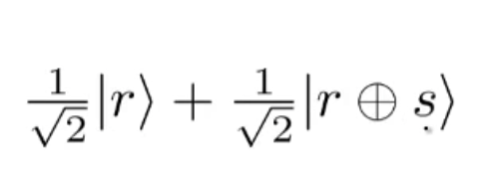
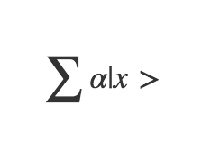
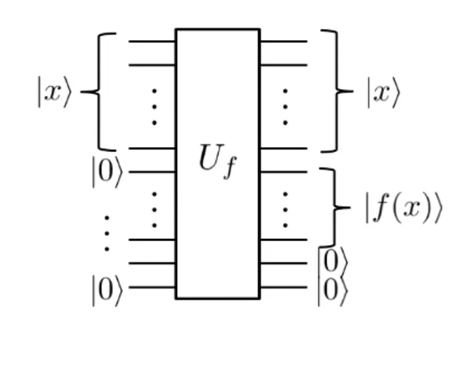
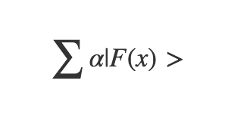
Step 1
-The first step is to produce a random superposition such as:
-The input to the quantum program is x and 0s and the output is
x, f(x) and 0’s.
-The whole point of quantum computing is to evaluate it over a
Super-position.
-Now we need to look at the type of superposition
we need to feed in.

Slide 20
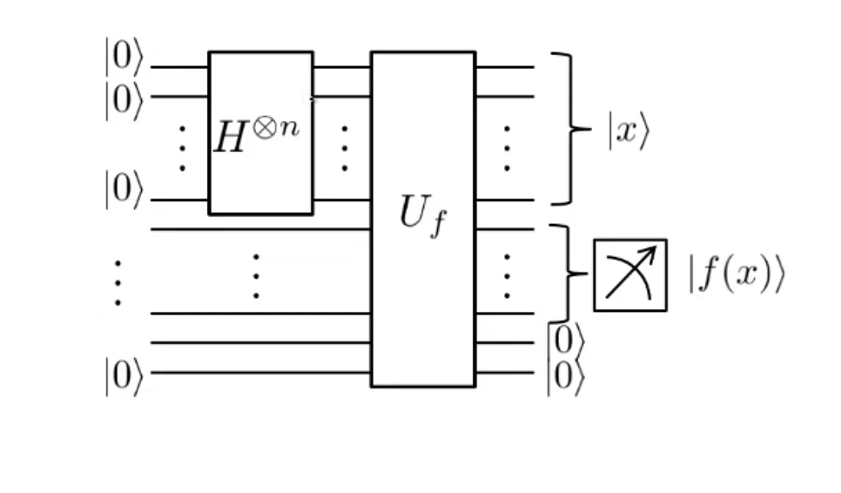
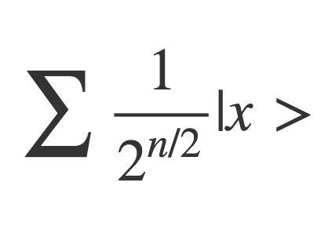
Step 1
So here’s the idea,
We start with an input of x and 0’s and run them through the hadamard transform.
Now that we have a uniform superposition over n bit strings, we evaluate f() over this to get the output.

Slide 21
Step 1
Let us say we get some random string ‘a’ = f(r) from the measurement of ‘f’, we know that f is a 1->2 function, this means there is some value f(r) = a and a = f(r+s).
When we measure the function f, the super-position collapses to the parts consistent with output ‘a’. We need to cross out the values in the super position of x that are no equal to ‘a’ so that we get the final super position as ...

Slide 22
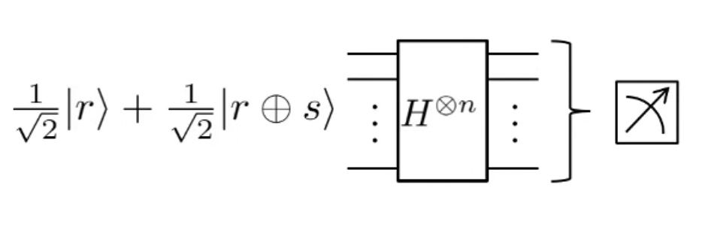
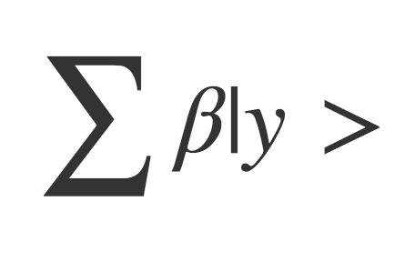
Step 2
The next step is to apply fourier sampling to the super-position.
The result of the fourier transform is in the form … . . Next we take the measurement of the output and get some value ‘y’ such that y = 0 mod(2).

Slide 23
Step 3
Now we repeat the sampling n-1 times to get a set of linearly independent equations.
We can solve for x from these equations.

Slide 24
Conclusion
This algorithm was designed in 1994 to demonstrate the use of quantum computing and is called Simon’s algorithm.
A classical algorithm to solve this black box will typically be in O(2^{n/2}), whereas, a Quantum algorithm can solve this in O(n), this provides an exponential speedup.

Slide 25
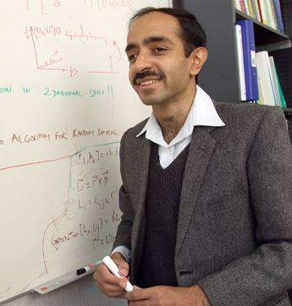
Quantum Search Algorithm
Lov Kumar Grover
Notes:
Param

Slide 26

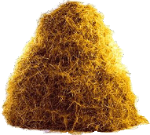
Grover’s Algorithm
Digital Haystack
0
1
2
:
x
:
N-1
Needle
Notes:
Why is it so important problem?
It helps in solving NP Complete problem, such as SAT

Slide 27
Grover’s Algorithm
Problem : Given boolean function f : { 0, 1, … , N-1 } ⇒ { 0, 1 }. Find x : f(x) = 1
Uf
𝚺 αx |x>
𝚺 αx |x>
|0>
f(x)
𝚺 αx |x> |0>
𝚺 αx |x> f(x)

Slide 28
Grover’s Algorithm
Grover’s Algorithm involves following two steps:
Phase Inversion
𝚺 αx |x> ⇒⇒⇒ 𝚺 αx |x> : x is not x* - αx* |x*>
Inversion about the Mean(μ)
𝚺 αx |x> ⇒⇒⇒ 𝚺 (2μ - αx) |x> μ = 𝚺 αx / N

Slide 29
Initialization
Phase Inversion
Inversion about the Mean
|0>
:
:
|0>
H
Uf
H
Ug
H
|->
Repeating this √N iterations

Slide 30
H
Ug
H
𝚺 αx |x>
|->

Slide 31
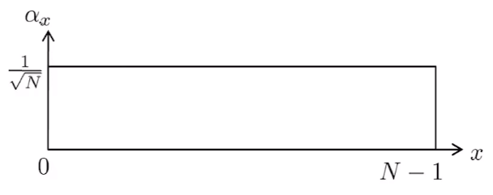
DELETE
Initialization
Iterating √N times we get the amplitude of x* as 1/√2

Slide 32
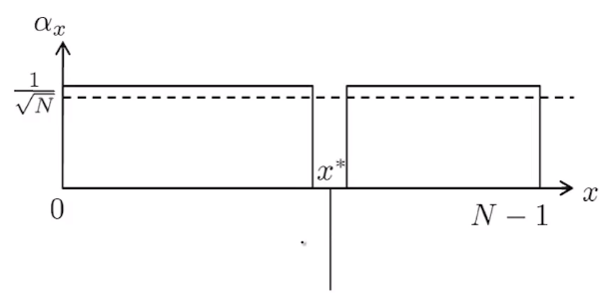
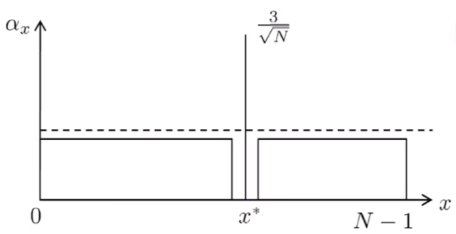
Grover’s Algorithm
Inversion about the Mean
Initialization
Phase Inversion
Iterating √N times we get the amplitude of x* as 1/√2

Slide 33
Phase Inversion
𝚺 αx |x> ⇒ 𝚺 αx (-1)^f(x) |x>
Uf
Uf
f(x) |0> |1>
b
|0> |0> |1>
|1> |1> |0>
|-> |-> - |->
|x>
|x>
|x>
(-1)^f(x) |x>
|b>
f(x) ⊕ b

Slide 34
Inversion about the Mean(μ)
𝚺 αx |x> ⇒ 𝚺 (2μ - αx) |x>
H
Ug
H
𝚺 αx |x>
|->
g: { 0, 1 }^n ⇒ { 0, 1 }
If g(0…...0) = 0
Else g(y) = 1 where y is not 0…….0

Slide 35
Grover’s Algorithm Quantum Circuit
Initialization
Phase Inversion
Inversion about the Mean
|0>
:
:
|0>
H
Uf
H
Ug
H
|->
Repeating this √N iterations

Slide 36
Future and Conclusion

Slide 37
Future of Quantum Computing
Cyber security:
Pros: Quantum key distribution will protect us :) an ultra-secure communication method that requires a key to decipher a message. Thanks to the peculiar properties of quantum mechanics, if the message gets intercepted, no one else can read it.
Cons: Standard encryption like RSA will fail
Traffic Control:
Quantum computers can help to streamline traffic control. They will be able to quickly calculate the optimal routes concurrently which allows for efficient scheduling and would reduce traffic congestion.
Drug Design:
Quantum computers will be able to analyze multiple molecules, proteins and chemicals simultaneously, this will help chemists develop drugs faster than traditional methods.
Notes:
Laksh

Slide 38
Conclusion
What algorithms will be discovered next?
Can quantum computers solve NP Complete problems in polynomial time?
Decoherence - the tendency of a quantum computer to decay from a given quantum state into an incoherent state as it interacts with the environment.
Notes:
Param

Slide 39
Resources

Slide 40
Useful Resources
David Deutsch’s Lectures
http://quiprocone.org/Protected/DD_lectures.htm
Umesh Vajirani’s Lectures on Quantum Mechanics and Quantum Computing https://www.youtube.com/watch?v=OkkAwRgcnWA&list=PL2fCZiDqOYYWR3UR9zkKrmW03igCZSL7P
Timeline of Quantum Computing
https://en.wikipedia.org/wiki/Timeline_of_quantum_computing
Quantum Frontiers (CalTech)
https://quantumfrontiers.com/2013/08/22/the-most-awesome-animation-about-quantum-computers-you-will-ever-see/
Unboxing a Quantum Computer - DWave https://www.youtube.com/watch?v=60OkanvToFI
Algorithms implemented by 1QBit https://1qbit.com/technology/
IBM QuBit Simulator https://quantumexperience.ng.bluemix.net/qx/editor
Notes:
Param

Slide 41
Questions ?

